Slide 1
Vandalia Health
Patient Safety

Slide 2
Culture of Safety
Fostering a shared commitment to safety at every level—where proactive risk prevention, open communication, and accountability are embedded in daily practices and decision-making—is essential for healthcare organizations to reduce medical errors, prevent staff burnout, and promote greater job satisfaction.

Slide 3
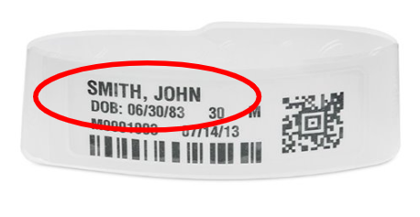
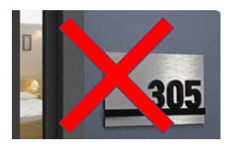
Patient Identification
Verify:
  Patient’s Full Name
  Patient’s Full Date of Birth
    Month/Day/Year
                Not Room Number!

Slide 4

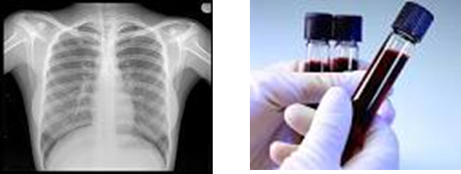

Critical Results Reporting
Report critical results to ordering provider within 30 minutes.
  Laboratory results
  Diagnostic imaging results
Documentation must be present in EMR.

Slide 5

Medication Safety
Bar code scanning should be done, where available, on every medication and every patient.
If you receive an alert, STOP.
If you are unable to resolve the alert, consider having another nurse verify and call the pharmacy for assistance.
Every Patient, Every Medication!

Slide 6
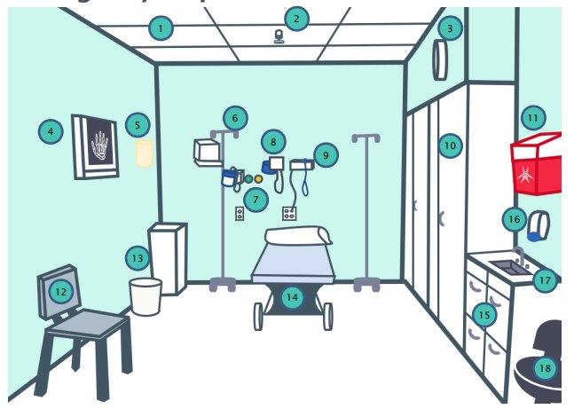
Identify Environmental Safety Risks
Assess features in the physical environment that could be used to attempt suicide and take necessary action to minimize the risks​
Screen all patients being treated primarily for a behavioral health condition for suicide ideation using a validated screening tool

Slide 7
Universal Protocol
Preventing Wrong Site, Wrong Procedure, and Wrong Person Surgery
Step 1: Implement a pre-procedure process to verify the correct procedure, for the correct patient, at the correct site.
Step 2: Mark the procedure site before the procedure is performed and, if possible, with the patient involved.
Step 3: Conduct a time-out immediately before starting the invasive procedure or making the incision.

Slide 8

Everyone Has a Role in Patient Safety!
Nurses, Clinical Assistants ​
Physicians and APPs​
Patient and Family​
Clinical Staff​
Management​
Non-Clinical Staff ​
Administrative Staff
Please report all questions or concerns to the ​
Patient Safety Officer or Risk Management Department

